Slide 1
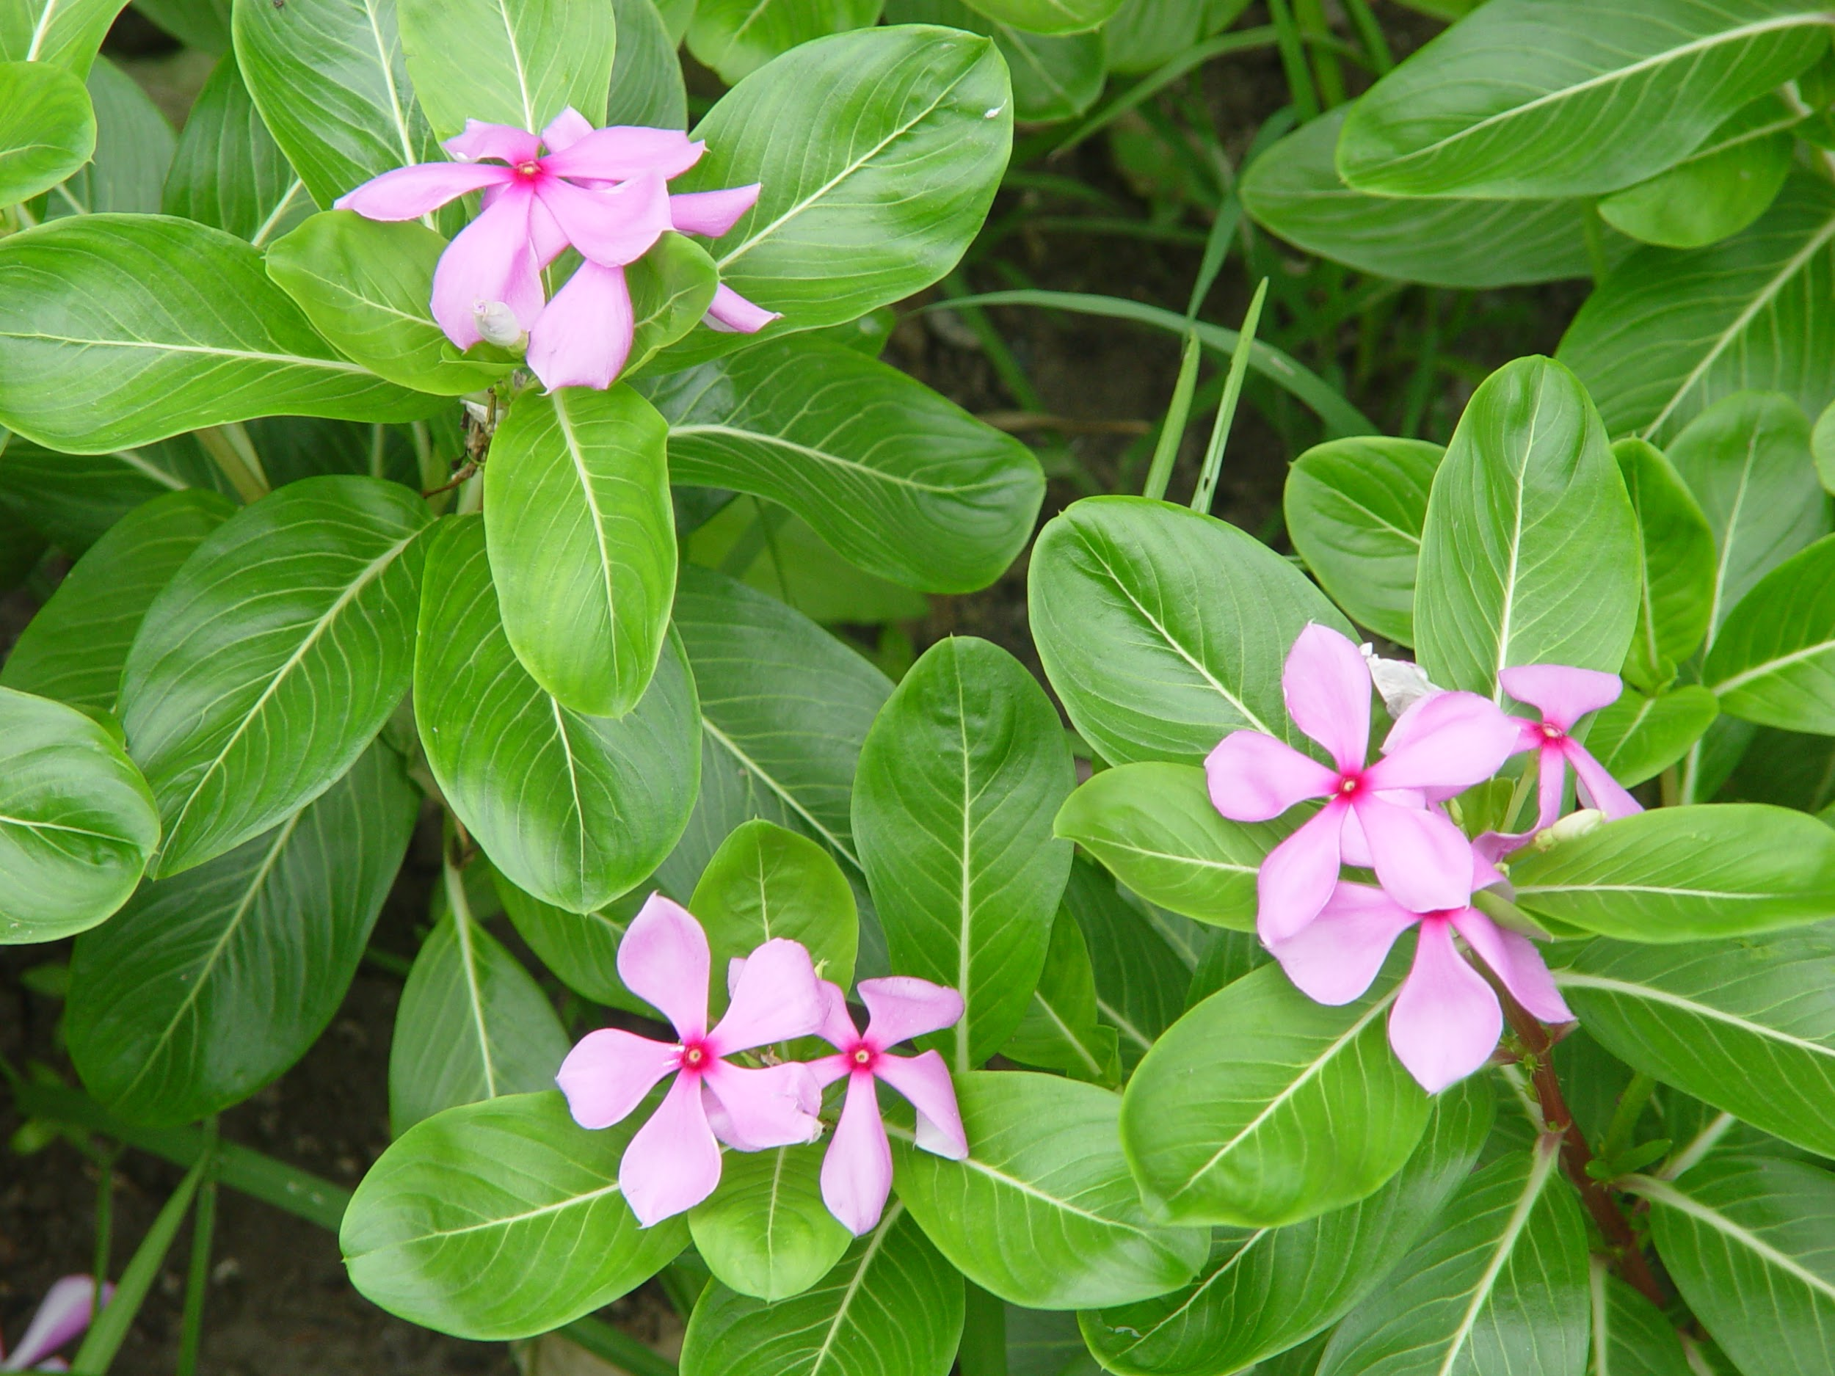
Planning Presentation
The Periwinkles
November 29th, 2018

Slide 2
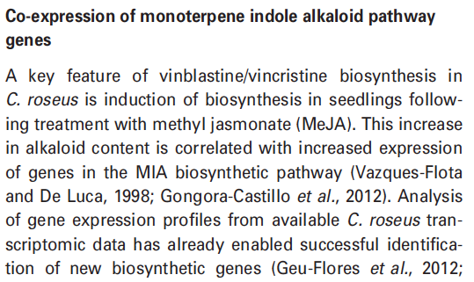
Research Question
Which pathways are affected by induction with methyl jasmonate and ethylene?

Slide 3
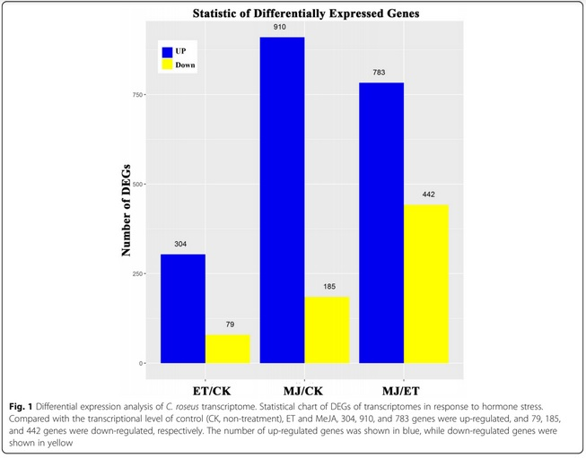
Goals we must achieve
Read quality
Read trimming
Genome Mapping
Transcriptome identification
Identify pathways
Gene clustering
Differential expression analysis
Enrichment analysis
Notes:
Read quality
Read trimming
Genome Mapping
Transcriptome identification
Identify pathways
Differential expression analysis

Slide 4
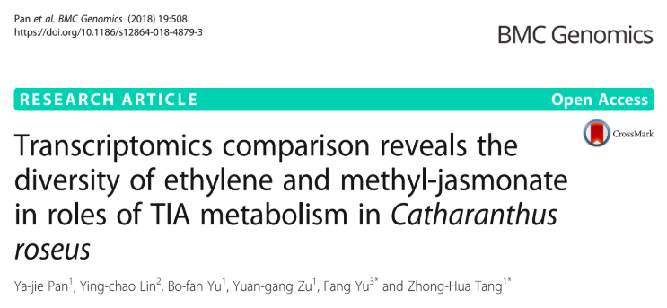
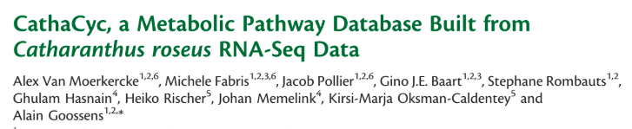
Goals we should and could achieve
We should compare our results with the papers’.
Predict biosynthetic pathway gene clusters using Plantismash with genomes V1 and V2.
Find missing genes in the pathway
Compare the behaviour of differential expression with the different cultures

Slide 5

Timeline
Thu 29/11: Planning presentation
Thu 06/12: Individual goals met
Fri 07/12: Progress presentation
Tue 11/12: Pipeline completion
Wed 12/12: Prepare final presentation
Thu 13/12: Final presentation
Fri 21/12: Final report deadline

